Slide 1
Introduction
Many people today face problems when trying to get healthcare. They often delay going to the doctor because they worry about high medical costs, long waiting times, or not knowing if their symptoms are serious.
This can make their health problems worse. Finding the right doctor or hospital is also a challenge, especially for people living in rural areas or older adults who may not know where to go. Existing online tools that help with health issues mostly use text, which can be hard for some people to use, especially the elderly.
These tools also do not always give accurate information about diseases or recommend nearby doctors, leaving people unsure of what to do next

Slide 2
Motivation
The goal of our project is to make healthcare simple and easy for everyone. Many people delay visiting the doctor due to worries about cost, long wait times, or not being sure about their symptoms.
Our project aims to reduce this hesitation by providing quick and reliable health advice through voice commands. Users can just talk about their symptoms, and our system will guide them to the right information and nearby doctors.
This will be especially helpful for older adults and people in rural areas who may have trouble finding the right healthcare. Our project aims to give people fast, accurate, and easy-to-understand medical advice, helping them take better care of their health without any stress or confusion.

Slide 3
Literature Review
S.No | Author and Year | Objective | Algorithm used | Advantages | Disadvantages
1 | Ubaid Ur Rehman , Dong Jin Chang , Younhea Jung , Usman Akhtar Muhammad Asif Razzaq and Sungyoung Lee | Medical Instructed Real-Time Assistant for Patients with Glaucoma and Diabetic Conditions:a virtual medical assistant designed to help patients with glaucoma and diabetes. | Deep learning, voice recognition | Security and Privacy,Specialization in Specific Conditions | Limited Scope of Diseases,Potential for User Error
2 | Guangzhi Xiong, Qiao Jin, Xiao Wang, Minjia Zhang , Zhiyong Lu, , Aidong Zhang | Improving Retrieval-Augmented Generation in Medicine with Iterative Follow-up Questions:This project aims to improve the ability of large language models (LLMs) to answer complex medical questions by allowing them to ask follow-up questions. | LLM.RAG | Iterative Approach,Comprehensive Evaluation | Cost,When Hyperparameter tuning the model can be time-consuming and slow
3 | Mohd Usamaa , Belal Ahmada , Wenjing Xiaoa , M. Shamim Hossainb , Ghulam Muhammadc. | Self-attention Based Recurrent Convolutional Neural Network for Disease Prediction Using Healthcare Data:a new computer-based method for predicting diseases by analyzing clinical text data from medical records. This is important because early diagnosis can help in treating diseases more effectively | (RCNN) and Self-attention mechanism | Handling of Unstructured Data,Real-world Application | Overfitting,Complexity

Slide 4
S.No | Author and Year | Objective | Algorithm used | Advantages | Disadvantages
4 | Mlađan Jovanovic , Singidunum University, 160622 Belgrade, Serbia Marcos Baez , LIRIS - Claude Bernard University Lyon 1, 69100 Villeurbanne, France Fabio Casati , University of Trento, 38122 Trento, Italy, and ServiceNow, Santa Clara, CA 95054 USA | Chatbots as Conversational Healthcare Services:The project focuses on the evaluation of healthcare chatbots designed to assist in diagnosis, prevention, and therapy. | Random Forests | Continuous Learning and Improvement,Integration with Healthcare Systems | Limited Scope,Lack of Continuity
5 | Safikureshi Mondal a, Anwesha Basu b , Nandini Mukherjee c | Building a Trust-Based Doctor Recommendation System on Top of Multilayer Graph Database:The project is about creating a doctor recommendation system that uses a multilayer graph database to store and analyze patient-doctor relationships. | Trust Factor Calculation | The graph database is better than traditional databases | the graph database requires more RAM to load the data.
6 | Christian J. Wiedermann , Angelika Mahlknecht , Giuliano Piccoliori and Adolf Engl | Redesigning Primary Care: The Emergence of Artificial-Intelligence-Driven Symptom Diagnostic Tools:AI-driven symptom checker to assist general practitioners (GPs) and patients in managing primary healthcare needs. This tool is designed to gather patient-reported symptoms, analyze them using AI algorithms, and provide preliminary assessments or recommendations before a consultation with a GP. | Bayesian Network | Efficiency in Medical History Taking ,Bridging the Gap Between Patients and GPs | Not as Helpful for Rare Diseases,Accuracy Concerns

Slide 5
S.No | Author and Year | Objective | Algorithm used | Advantages | Disadvantages
7 | Sanjay Chakraborty, Hrithik Paul, Sayani Ghatak, Saroj Kumar Pandey, Ankit Kumar, Kamred Udham Singh, and Mohd Asif Shah | An AI-Based Medical Chatbot Model for Infectious Disease Prediction used to bring awareness and to educate about the preventions of infectious diseases , this chatbot was developed to predict infectious disease specifically COVID-19 symptoms , the user gives voice or text based inputs which is converted to text and these text data is used to predict disease related to COVID -19 only and respond him via text | LSTM (LONG SHORT TERM MEMEORY) model and RNN (RECURRENT NEURAL NEWTORK) and NLP (NATURAL LANGUAGE PROCESSING) based on RAD | This AI model showed 94.32% accuracy and a low loss of 0.1232 thus, effectively predicting and providing information about COVID-19 and RNN models also show 90% precent accuracy. NLP model effectively interprets user text data, to be used for the LSTM model itself to predict the outcomes more accurately. | This chatbot is applicable for COVID-19 disease only with no extensive voice-based automation for the Chatbot to reply to the queries of the user (less interactive).
8 | Sumit Pandey, Srishti Sharma | A comparative study of retrieval-based and generative-based chatbots using Deep Learning and Machine Learning . This project aims at analyzing both retrieval-based and generative AI chatbots using deep learning techniques to address medical issues among college students. | The study evaluates six different AI models, including RNN, LSTM, BI-LSTM, and GRU for retrieval-based systems, and CNN for generative-based models | Overall CNN shows more accuracy and generates responses effectively compared to other models tested by them. | This chatbot is limited over small sample size or observations and needs a large sample dataset which are accurate which will help the model to predict outcomes effectively and also predicts outcomes for multiple psychological symptoms.
9 | Arun Babu, Sekhar Babu Boddu | BERT-Based Medical Chatbot: Enhancing Healthcare. This project’s goal is to developed a BERT-based medical chatbot designed to improve healthcare communication and accessibility through advanced natural language understanding. | BERT (Bidirectional Encoder Representations from Transformers) and NLP | BERT - based medical chatbot produced 95% accuracy over disease predictions for some specific disease. | Model effectiveness is unpredictable for uncommon medical conditions and lacks continuous learning over health care scenarios

Slide 6
S.No | Author and Year | Objective | Algorithm used | Advantages | Disadvantages
10 | Srinivasa Rao Burri, Vasundhara Vijay Ghorpade, Vishal Dutt, and Kumari Lipi | The Rise of Virtual Health Assistants: Chatbot Based Healthcare Support and Counseling Using Recurrent Neural Networks (RNNs) . This study depicts the use of AI based assistant chatbot to provide health care information and predicts illness using text-based inputs form user this chatbot is developed using RNN i.e. LSTM in specific and using MIMIC-III dataset which contains over 40,000 health-oriented information of patients admitted to a prestigious academic medical canter’s critical care unit (ICU). | RNN (RECURRENT NEURAL NETWORK), LSTM (LONG SHORT-TERM MEMORY) | LSTM based chatbot show 90% accuracy and 89% in F1 score which is higher compared to Random Forest, Support Vector Machine, and Decision Tree | RNN model finds it hard to store large sequence of information in the past to predicts outcomes effectively affecting its accuracy.
11 | Siva Sai, Aanchal Gaur, Revant Sai, Vinay Chamola, Mohsen Guizani, and Joel J. P. C. Rodrigues | A framework for implementing machine learning in healthcare based on the concepts of preconditions and postconditions . This project depicts the use preconditions and postconditions approach to gather user data and analyse them before being training to the ML model itself. This paper says the barriers of implementing AI in medical health care, overcome these issues by collaborating with clinical experts | Not mentioned | This implementation of preconditions and postconditions can help produce system with less biased output and more technical approach over effect data collections in healthcare usages and its implementation | Safety and model poor evaluations in health care perspective and data updating can cause a problem in the implementations of AI in healthcare

Slide 7
S.No | Author and Year | Objective | Algorithm used | Advantages | Disadvantages
12 | Soumiki Chattopadhyay and Souti Chattopadhyay | Generative AI for Transformative Healthcare: A Comprehensive Study of Emerging Models, Applications, Case Studies, and Limitations . | Generative AI (GAI) models like ChatGPT, DALL-E, and Bard. GAI algorithms for medical image analysis and disease detection. | Generative AI can be trained and used effectively to address various health care issues with proper dataset and training feedbacks and if the model is evaluated and analyzed with medical experts it has a dynamic effect on health care sector | Data bias and quality issues leading to inaccurate results and Patient privacy and data security concerns. High costs associated with implementing GAI in healthcare
13 | Durga Chavali1 , Vinod Kumar Dhiman , Siri Chandana Katari | AI-Powered Chatbot for Medical Diagnostics and Personalized Treatment Recommendations | Deep Learning, Natural Language Processing (NLP), and Reinforcement Learning | • Provides personalized treatment recommendations. • Enhances diagnostic accuracy. • Reduces waiting times for patients | • Limited to specific medical conditions. • May struggle with ambiguous or rare symptoms. • Requires large datasets for training.
14 | Prakash Nathaniel Kumar Sarella, Vinny Therissa Mangam | Cloud-Based Healthcare Chatbot Integration for Enhanced Patient Interaction | Cloud-based deep learning models, NLP algorithms. | • Real-time interaction and accessibility. • Scalable cloud-based infrastructure. • Reduces in-person visits. | • Dependent on stable internet connectivity. • Higher chances of data breaches and privacy issues. • Latency in response time.

Slide 8
S.No | Author and Year | Objective | Algorithm used | Advantages | Disadvantages
15 | Yu‑Hao Li, Yu‑Lin Li, Mu‑Yang Wei1 & Guang‑Yu Li | Machine Learning in Health Chatbots for Early Disease Detection | Supervised machine learning models for disease detection. | • Timely detection of diseases. • Reduces the need for frequent doctor visits. • High diagnostic accuracy. | • Accuracy is highly dependent on input data quality. • Limited in handling multi-symptom diseases. • Requires regular model updates for new diseases.
16 | Alrashdan,QusaAl- Maatouk Maen, AlrshdanTeo Min Xuan | A Smart Healthcare System using AI Chatbots for Symptom Assessment | AI-based symptom analysis using machine learning and NLP. | • Immediate assessment and advice. • Enhances healthcare accessibility. • Reduces wait times in healthcare facilities. | • Prone to misdiagnosis in complex cases. • Data privacy concerns. • Difficult to address non-verbal symptoms.
17 | Bertl, Markus & Piho, Gunnar & Draheim, | AI Chatbots for Personalized Healthcare: Trends and Challenges | NLP and machine learning models tailored to personalized healthcare delivery. | • Tailored healthcare solutions. • Increased patient satisfaction. • Reduces healthcare costs. | • Ethical concerns in personalized care recommendations. • Regulatory and compliance challenges. • Privacy risks with patient data.

Slide 9
S.No | Author and Year | Objective | Algorithm used | Advantages | Disadvantages
18 | Akangbe, Raphael & Charles-Chinkata, Tyna. | Exploring the Potential of NLP-Driven Healthcare Chatbots | NLP algorithms like BERT and GPT for conversational enhancement. | • Enhanced patient interaction. • Provides more human-like communication. • Can handle more complex queries. | • Misunderstanding of patient input. • High computational costs for processing. • Language limitations in multilingual settings.
19 | J.C. Chow, L. Sanders, K. Li | Data-Driven Approaches for Medical Chatbot Systems | Data-driven machine learning models with big data analytics. | • Improves diagnostic accuracy with large datasets. • Provides data-backed medical insights. • Enhances model training and prediction accuracy. | • Requires extensive data collection. • Potential for data privacy violations. • High cost of data storage and processing.
20 | L. Ni, C. Lu, N. Liu, J. Liu, Mandy | Integrating Chatbots in Telemedicine: The Future of Patient Engagement | Machine learning and rule-based systems for patient interaction. | •Facilitates remote patient care. •Increases engagement through interactive sessions. •Reduces doctor workload. | Relies on a stable internet connection. Limited diagnostic capacity for complex cases. Can’t replace human empathy in patient care.

Slide 10
S.No | Author and Year | Objective | Algorithm used | Advantages | Disadvantages
21 | I.C. Chang, Y.S. Shih, K.M. Kuo | Enhancing Patient Care with AI Chatbots: A Comprehensive Study | Supervised learning and deep learning models. | • Facilitates continuous patient monitoring. • Reduces the strain on healthcare professionals. • Offers timely diagnostic support. | • Requires regular updates for medical accuracy. • Difficult to integrate into complex healthcare systems
22 | L. Athota, V.K. Shukla, N. Pandey, A. Ranat | The Role of Chatbots in Digital Health Transformation | AI-driven chatbot models integrated with telemedicine systems. | • Improves access to healthcare services. • Enables telemedicine and virtual consultations. • Reduces the strain on physical healthcare infrastructure. | • May not handle complex or emergency cases effectively. • Potential for incorrect diagnostics in certain scenarios.

Slide 11
Problem Statement
Existing chatbots rely on text-based communication and lack natural, human-like voice interactions.
The current system uses the K-Nearest Neighbors (KNN) algorithm for disease prediction, which limits the accuracy and variety of predictions.
They are limited and can only predict about 10 diseases.
These chatbots also cannot give information about nearby doctors or their locations.

Slide 12
Proposed Method
Advanced Voice Interactions: The Virtual Voice Health Assistant offers advanced AI-powered voice interactions, making the communication feel more natural and accessible for users.
Enhanced Multiple Disease Prediction: By collecting user information and querying patients about their symptoms, the system predicts a wider range of diseases with improved accuracy, addressing the limitations of the KNN algorithm.
Personalized Doctor Recommendations: The system provides personalized advice, recommending consultations with doctors and suggesting nearby specialists based on the predicted condition, which is not available in the existing chatbots.

Slide 13
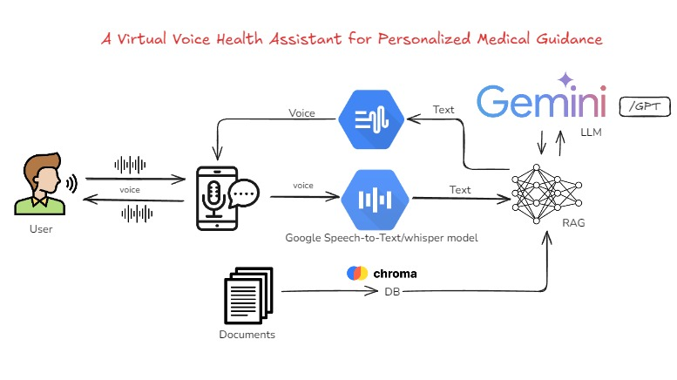
Architecture diagram

Slide 14
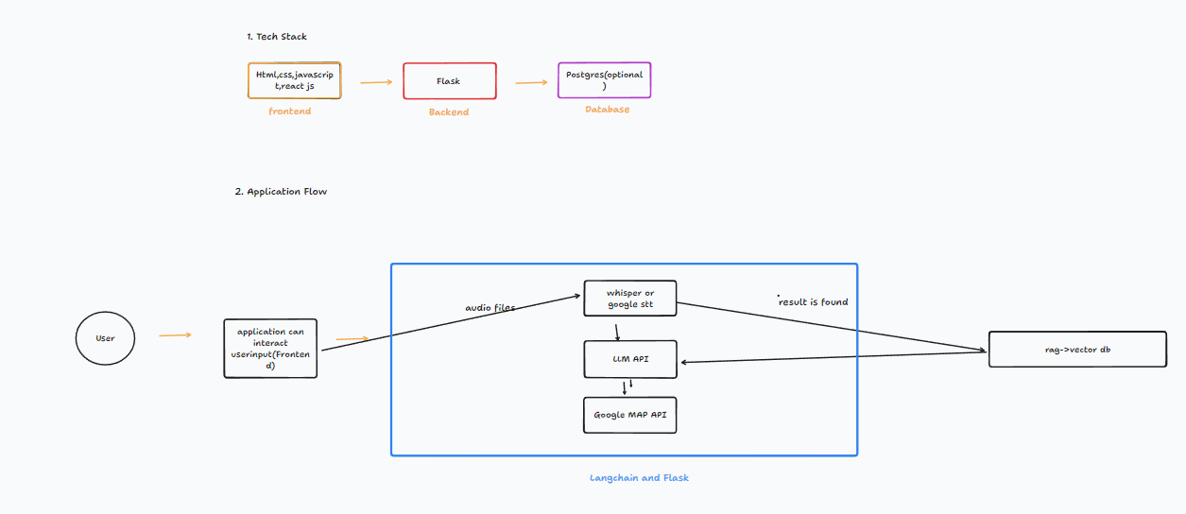
Project Design

Slide 15
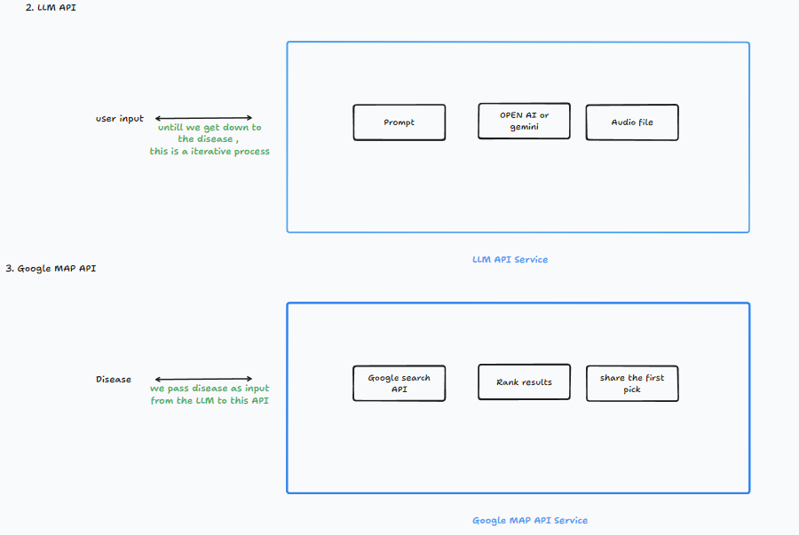
Project Design

Slide 16
Modules Identified
Voice-Based Assistance:
Implemented using speech recognition models like Google Text-to-Speech or Whisper Model for natural, human-like interactions.
Multiple Disease Prediction:
Utilizes Large Language Models (LLMs) to predict a wide range of diseases.
Employs the Retrieval-Augmented Generation (RAG) approach:First checks in a vector database (ChromaDB) using RAG.
If needed, it consults the LLM for further analysis.
Doctor Location Suggestions:
Uses Google API or SerpAPI to find and suggest nearby specialists based on the predicted disease, enhancing personalized care.

Slide 17
Evaluation Method
1.Cosine Similarity
Cosine similarity is a metric used to measure how similar two vectors (documents, phrases, or words) are irrespective of their size.
Accuracy: Measures how closely predictions match actual outcomes using cosine similarity between vectors.(Accuracy = (TP + TN) / (TP + TN + FP + FN))
Precision: Assesses the proportion of correct matches among the top results based on similarity scores.(Precision = TP / (TP + FP))
Recall: Evaluates the ability to retrieve all relevant results by comparing cosine similarity scores.(Recall = TP / (TP + FN))
F1-Score:Balances precision and recall, providing an overall measure of effectiveness using cosine similarity.(F1-Score = 2 * (Precision * Recall) / (Precision + Recall))

Slide 18
2.Negative Scenario Evaluation:Test Case: Evaluate the LLM's response to irrelevant questions, such as "Hi chatbot, how are you? Suggest a good movie." The LLM should not provide answers or suggestions unrelated to the medical domain, ensuring it stays focused on its intended purpose.
3.LLM Evaluation Framework:Deep Evaluation: Assess the LLM's performance using frameworks like Deep Eval or RAGAS. These frameworks evaluate how well the LLM processes and responds to user inputs, including accuracy, relevance, and coherence of the medical advice provided.

Slide 19
System Requirement
HARDWARE REQUIREMENTS:
Processor : Any Processor above 500 MHz
Ram : 8 GB
Hard Disk : 500 GB.
Input device : Standard Keyboard and Mouse.
Output device : VGA and High Resolution Monitor
SOFTWARE REQUIREMENTS:
Operating System : Windows
Programming Language : Python
Database : vector database(chromadb or Faiss)
Transformer model:LLM(Large Language model)- Gemini
IDE :Visual Studio Code

Slide 20
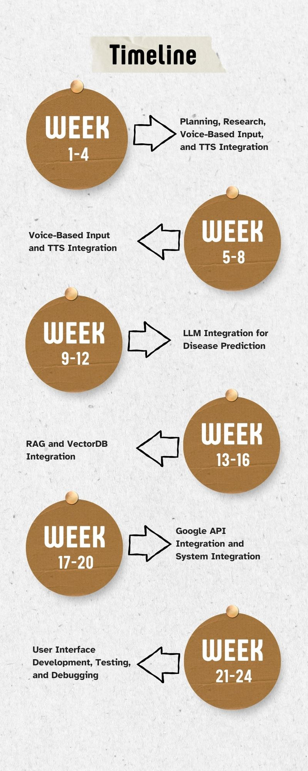
Time plan for project execution

Slide 21
25% of project work
Our main goal during this phase was to build a simple web application using Flask and connect it with the Gemini API to generate responses based on what users ask.
Work Achieved:
1. Backend Development:
We created a web app using Flask as the backend.
Integrated the Gemini API to handle questions from users and generate meaningful responses.
2. User Interface (UI):
A simple UI was designed where users can enter their questions. For example, if someone types “fever,” the system will give information related to fever.

Slide 22
3. Response Generation:
When a user asks a health-related question, like “fever,” the system responds with: "Fever" is a broad term. Are you asking about how to treat a fever, the causes, or are you concerned about a specific type of fever?
How It Works:
Users input their health-related questions.
The system uses the Gemini API to process the question and provide a helpful response.
Next Steps:
Continue improving the UI to make it more user-friendly.
Expand the range of health topics and refine the accuracy of the system’s responses.

Slide 23
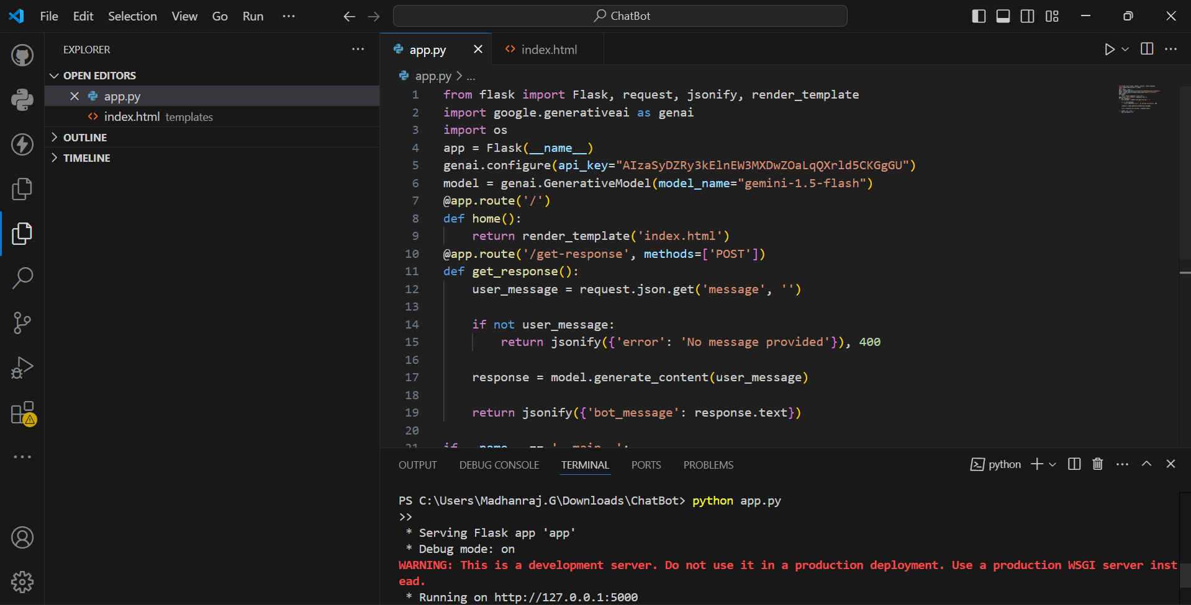

Slide 24
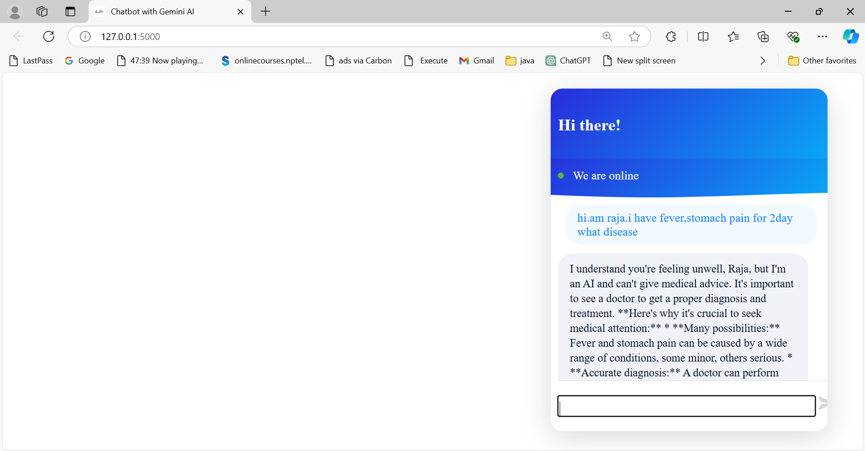

Slide 25
References
Roshan Bhaladhare and Parag Rishipathak, "Assessment of Quality Care in the Health Care Sector: A Systematic Review", IEEE Access, 2021.
Durga Chavali, Vinod Kumar Dhiman, and Siri Chandana Katari, "AI-Powered Virtual Health Assistants: Transforming Patient Engagement Through Virtual Nursing", Journal of Medical Systems (Springer), 2022.
Sanjay Chakraborty, Hrithik Paul, Sayani Ghatak, Saroj Kumar Pandey, Ankit Kumar, Kamred Udham Singh, and Mohd Asif Shah, "An AI-Based Medical Chatbot Model for Infectious Disease Prediction", IEEE Journal of Biomedical and Health Informatics, 2023.
Sumit Pandey and Srishti Sharma, "A Comparative Study of Retrieval-Based and Generative-Based Chatbots Using Deep Learning and Machine Learning", Artificial Intelligence in Medicine (Elsevier), 2021.
Arun Babu and Sekhar Babu Boddu, "BERT-Based Medical Chatbot: Enhancing Healthcare Communication Through Natural Language Understanding", Computational Linguistics (Springer), 2022.
Srinivasa Rao Burri, Vasundhara Vijay Ghorpade, Vishal Dutt, and Kumari Lipi, "The Rise of Virtual Health Assistants: Chatbot-Based Healthcare Support and Counseling Using Recurrent Neural Networks (RNNs)", ACM Transactions on Healthcare Computing, 2022.
Colin MacKay, William Klement, Peter Vanberkel, Nathan Lamond, Robin Urquhart, and Matthew Rigby, "A Framework for Implementing Machine Learning in Healthcare Based on the Concepts of Preconditions and Postconditions", Journal of Healthcare Engineering (Springer), 2021.

Slide 26
Siva Sai, Aanchal Gaur, Revant Sai, Vinay Chamola, Mohsen Guizani, and Joel J. P. C. Rodrigues, "Generative AI for Transformative Healthcare: A Comprehensive Study of Emerging Models, Applications, Case Studies, and Limitations", IEEE Access, 2023.
Ubaid Ur Rehman, Dong Jin Chang, Younhea Jung, Usman Akhtar, Muhammad Asif Razzaq, and Sungyoung Lee, "Medical Instructed Real-Time Assistant for Patient with Glaucoma and Diabetic Conditions", Sensors (MDPI), 2023.
Guangzhi Xiong, Qiao Jin, Xiao Wang, Minjia Zhang, Zhiyong Lu, and Aidong Zhang, "Improving Retrieval-Augmented Generation in Medicine with Iterative Follow-up Questions", Journal of Biomedical Informatics (Elsevier), 2022.
Mohd Usama, Belal Ahmad, Wenjing Xiao, M. Shamim Hossain, and Ghulam Muhammad, "Self-Attention Based Recurrent Convolutional Neural Network for Disease Prediction Using Healthcare Data", IEEE Journal of Biomedical and Health Informatics, 2022.
Safikureshi Mondal, Anwesha Basu, and Nandini Mukherjee, "Building a Trust-Based Doctor Recommendation System on Top of Multilayer Graph Database", ACM Transactions on Healthcare Computing, 2022.
Christian J. Wiedermann, Angelika Mahlknecht, Giuliano Piccoliori, and Adolf Engl, "Redesigning Primary Care: The Emergence of Artificial-Intelligence-Driven Symptom Diagnostic Tools", Journal of Medical Systems (Springer), 2023.
Prakash Nathaniel Kumar Sarella, "AI-Driven Natural Language Processing in Healthcare: Transforming Patient-Provider Communication", Journal of Medical Informatics (Elsevier), 2022
Shuroug A. Alowais, Sahar S. Alghamdi, Nada Alsuhebany, Tariq Alqahtani, Abdulrahman I. Alshaya, Sumaya N. Almohareb, Atheer Aldairem, Mohammed Alrashed, Khalid Bin Saleh, Hisham A. Badreldin, Majed S. Al Yami, Shmeylan Al Harbi, and Abdulkareem M. Albekairy, "Revolutionizing Healthcare: The Role of Artificial Intelligence in Clinical Practice", Journal of Artificial Intelligence in Medicine (Elsevier), 2023.

Slide 27
14.Yu-Hao Li, Yu-Lin Li, Mu-Yang Wei, and Guang-Yu Li, "Innovation and Challenges of Artificial Intelligence Technology in Personalized Healthcare", Nature Medicine, 2023.
15. M. Herz and P. A. Rauschnabel, "Understanding the Diffusion of Virtual Reality Glasses: The Role of Media, Fashion, and Technology", Technological Forecasting and Social Change, 138(2019), pp. 228–242.
16. H. Jafarkarimi, R. Saadatdoost, A. T. H. Sim, and J. M. Hee, "Behavioral Intention in Social Networking Sites Ethical Dilemmas: An Extended Model Based on the Theory of Planned Behavior", Computers in Human Behavior, 62(2016), pp. 545–561.
17. M. Bates, "Healthcare Chatbots are Here to Help", IEEE Pulse, 10(2019), pp. 12–14.
18. J. C. Chow, L. Sanders, and K. Li, "Impact of ChatGPT on Medical Chatbots as a Disruptive Technology", Frontiers in Artificial Intelligence, 6(2023), 1166014.
19. S. Tanwar, S. Tyagi, and N. Kumar, "Security and Privacy of Electronic Healthcare Records: Concepts, Paradigms, and Solutions", IET Healthcare Technology Letters, 2019.
20. A. K. Pandey, R. R. Janghel, R. Sujatha, S. Sathish Kumar, T. Sangeeth Kumar, and J. M. Chatterjee, "Coronago Website Integrated with Chatbot for COVID-19 Tracking", CEUR Workshop Proceedings, 2021, pp. 521–527.
21. N. Malik, A. Kar, S. N. Tripathi, and S. Gupta, "Exploring the Impact of Fairness of Social Bots on User Experience", Technological Forecasting and Social Change, 197(2023), 122913.
22.A. K. Kushwaha, "MarkBot: A Language Model-Driven Chatbot for Interactive Marketing in Post-Modern World", Information Systems Frontiers, 2021, pp. 1–18.
23.Y. Cheng and H. Jiang, "How do AI-Driven Chatbots Impact User Experience? Examining Gratifications, Perceived Privacy Risk, Satisfaction, Loyalty, and Continued Use", Journal of Broadcasting and Electronic Media, 64(2020), pp. 592–614..

